Slide 1
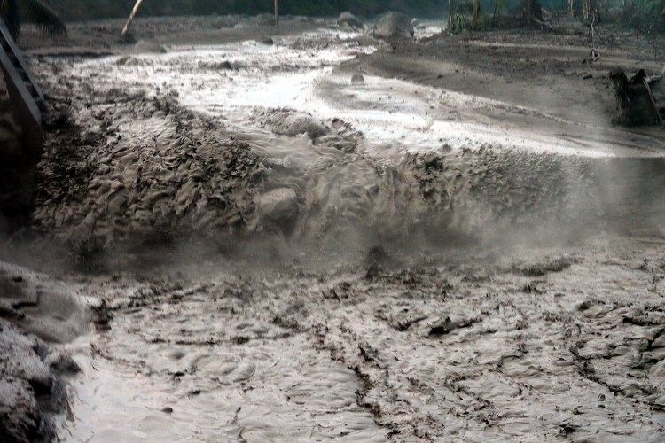
Physical Models of Lahars
Jaqueline Wharton (WTW), Shaunagh Downing, Jenny Delos Reyes, Will Graham, Laura Hattan (IMI), Eileen Russell, Philippe Trinh. ​

Slide 2

What is a Lahar?
A lahar is a violent type of mudflow or debris flow composed of a slurry of pyroclastic material, rocky debris and water. The material flows down from a volcano.
More violent lahars: velocities = O(10mph), H = O(10m), distances = O(100km)

Slide 3
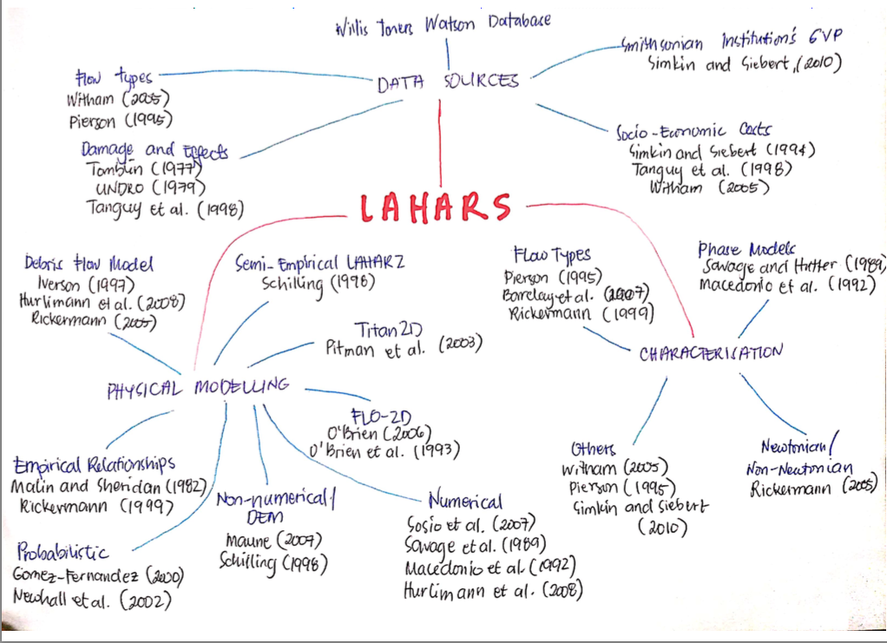
Literature Review

Slide 4
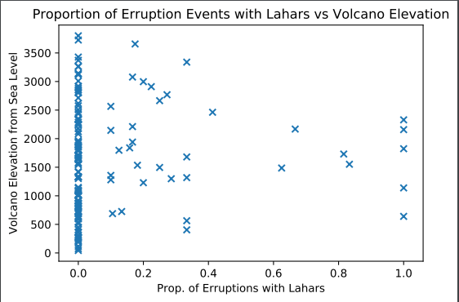
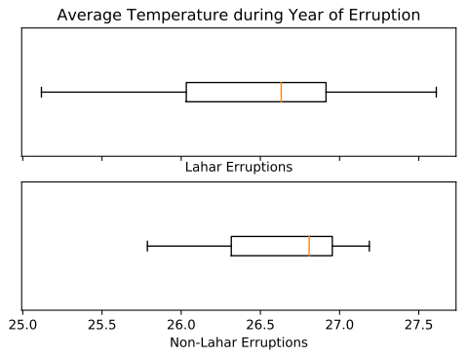
Statistical Analysis of the data
Open question: are there are site-specific characteristics that indicate a propensity for lahar events?
We know that early predictions/warning systems of lahar events have occurred with modest success---how are these done?
Possibilities: elevation, average yearly temperature, rainfall, proximity to large populations, soil type, etc.
Conclusions: Not enough time this week to analyze the set of data; remains an open question.

Slide 5
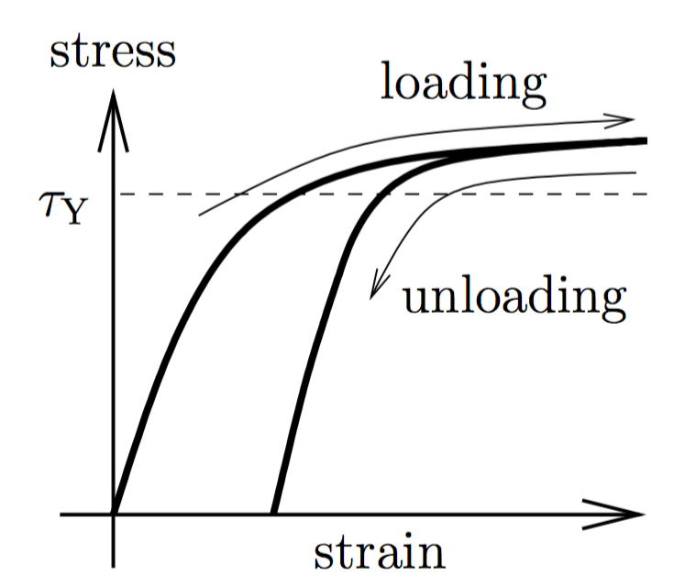
Challenges of modelling lahars
Q: Is a lahar a fluid or a solid?
A: Sometimes it is both fluid and solid! It can be modeled as a fluid but with complicated assumptions.
The main problem is how to characterise the stress tensor
Plasticity: characterised by stress-strain curve that has a critical yield stress after which the properties of the material change.
Navier-Stokes Equations:
Stress involving stress tensor
Gravity
Change in momentum

Slide 6
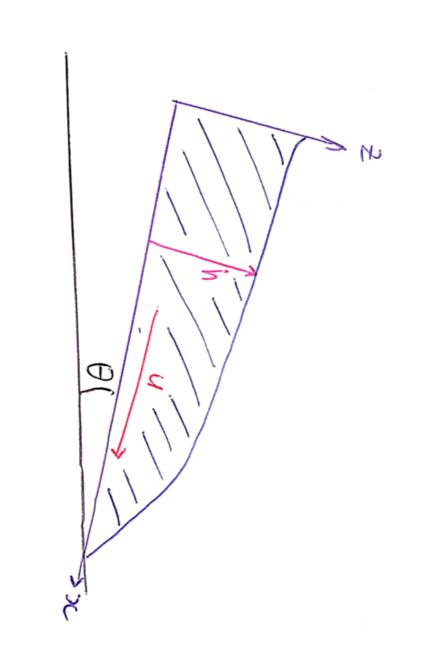
Creating a Mathematical Model.
Step 1: formulate conservation of mass under shallow-water assumption (thin-flows where velocities are averaged in the layer)
Consider a toy model of flow on a ramp.

Slide 7
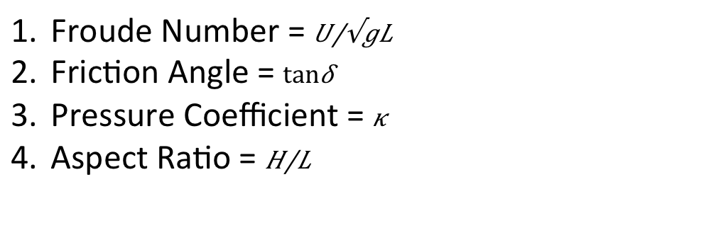
Creating a Mathematical Model.
Step 2: formulate the conservation of momentum equation
Step 2b: debate what goes into the stress tensor
Change in momentum
Gravity along flow
Downslope stress in fluid
Friction stress at bottom surface
Key non-dimensional parameters:
Froude Number = $\frac{U}{\sqrt{gL}}$
Friction Angle = $\tan{δ}$
Pressure Coefficient = $κ$
Aspect Ratio = $\frac{H}{L}$

Slide 8
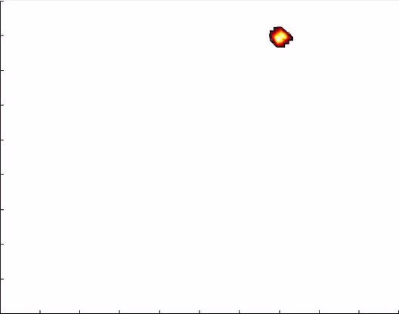
Simulations
There exist multiple available codes for simulating granular flows via shallow-water approximations (Titan2D, LaharFlow, etc.)
Codes largely differ by treatment of the stress tensor
Input: elevation map, source location, source size/strength, various properties of the terrain (going into the tensor)
O(10km) scale terrain with resolution on O(50m); solutions rendered for until ~20 minutes of flow; simulations take on the order of 1-10 minutes.

Slide 9
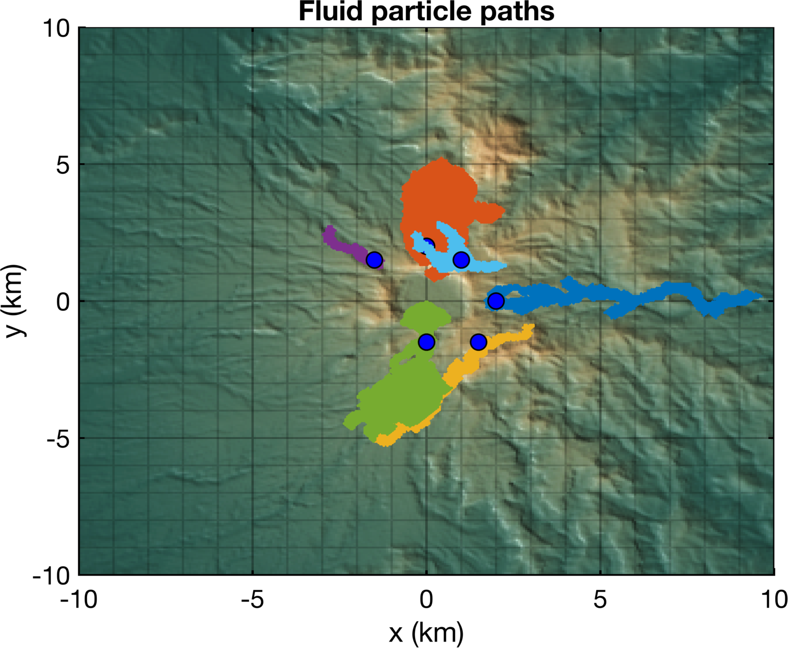
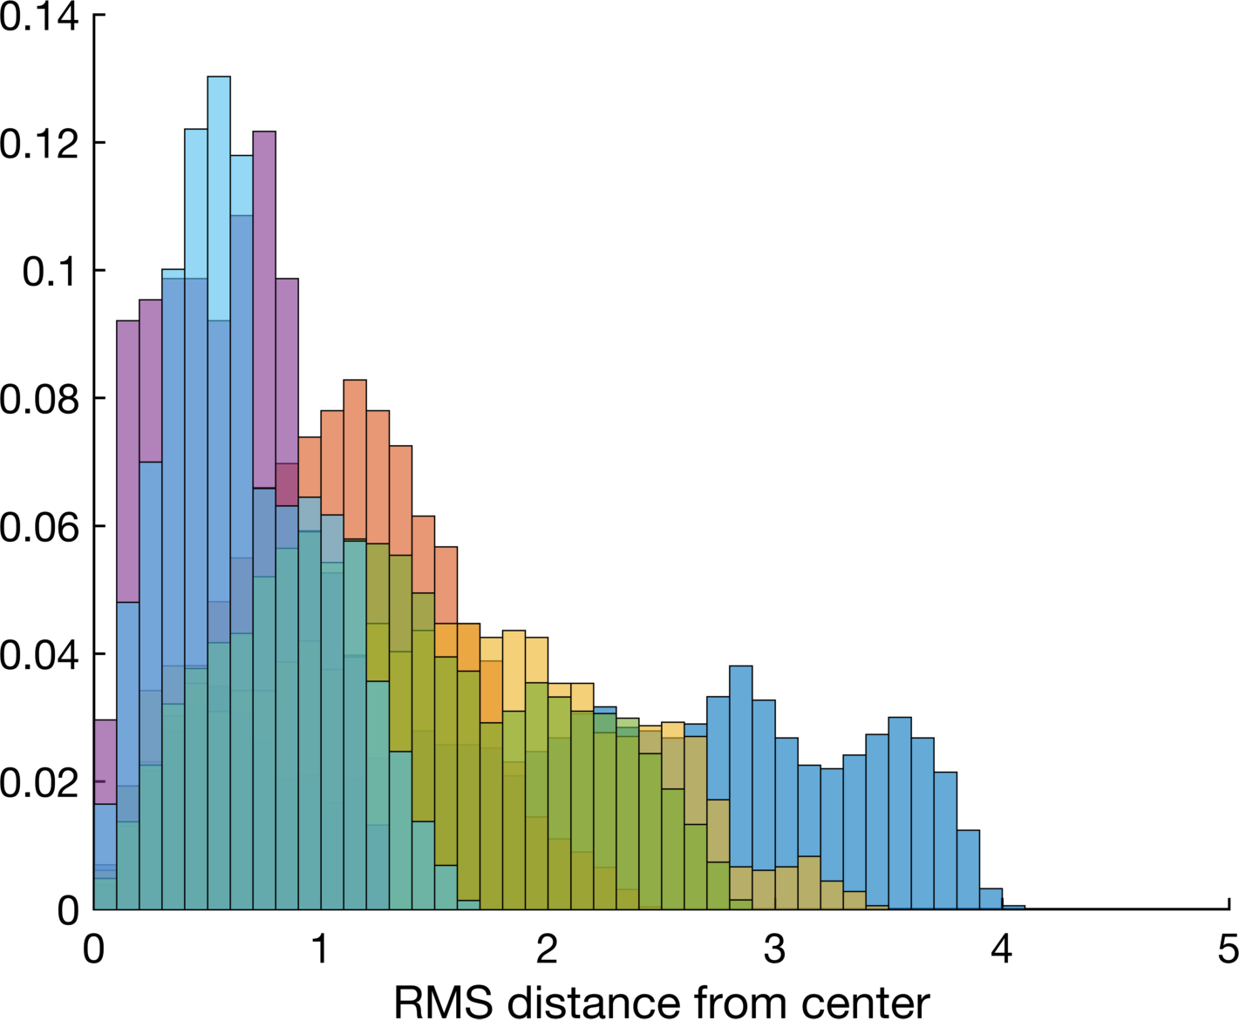
Stability analysis
Whether a broad index can/should be developed to evaluate risk may depend on the stability of flows subject to perturbations in the initial conditions.
We can observe that on O(1km) range flows are largely unstable to perturbing the initial location --- i.e. this is very topographically dependent!
Little spread
Notice large spread

Slide 10
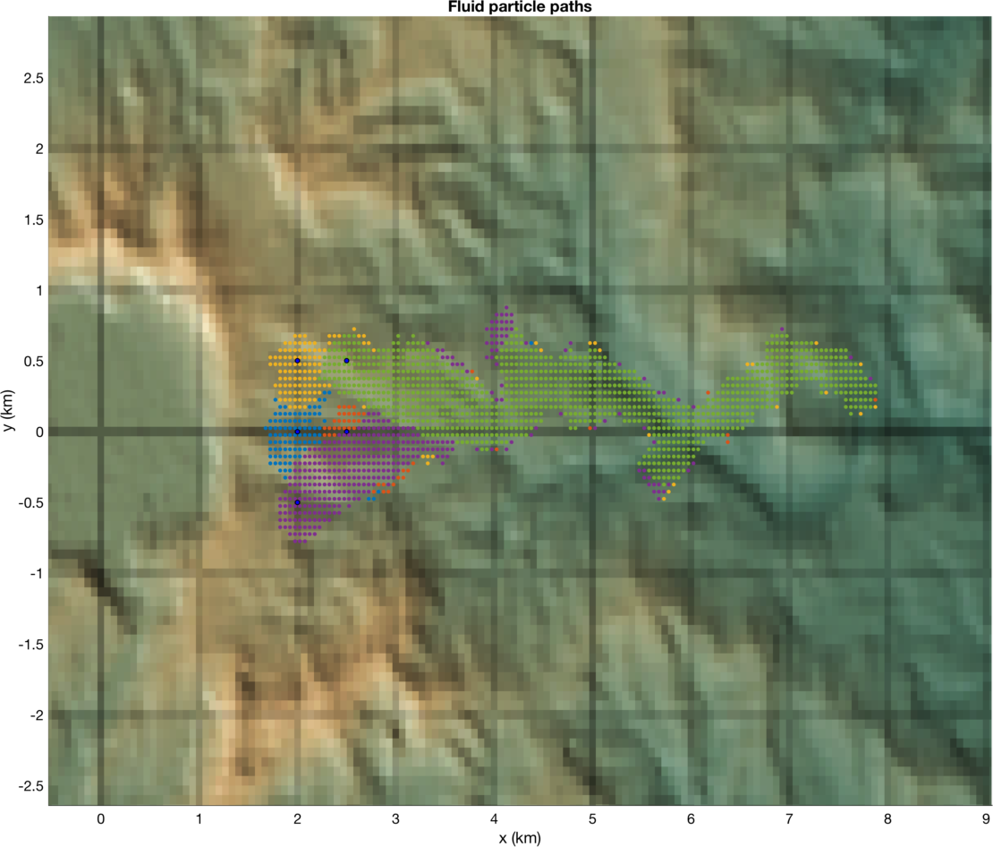
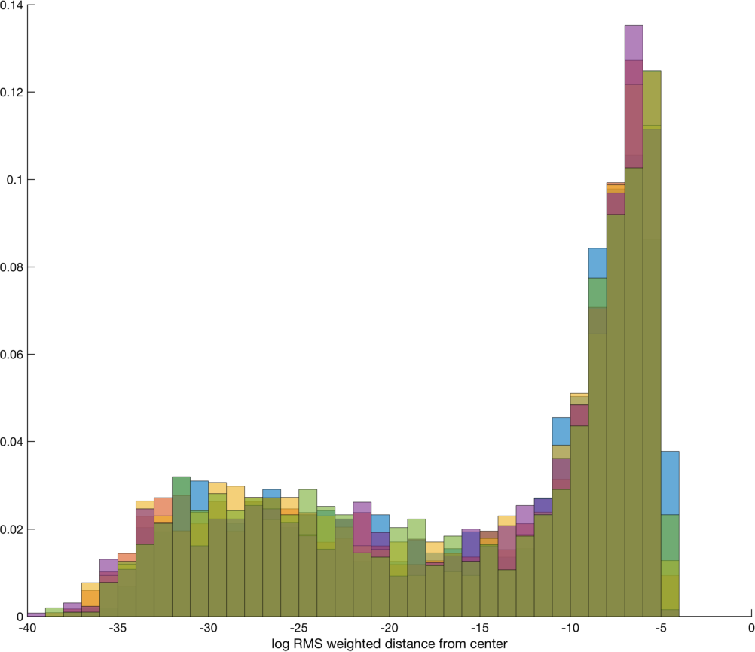
Stability analysis
Whether a broad index can/should be developed to evaluate risk may depend on the stability of flows subject to perturbations in the initial conditions.
We can observe that on O(1km) range flows are largely unstable to perturbing the initial location --- i.e. this is very topographically dependent!
Flows are relatively stable for perturbations of initial conditions under 1km.
Distribution of fluid paths largely the same

Slide 11
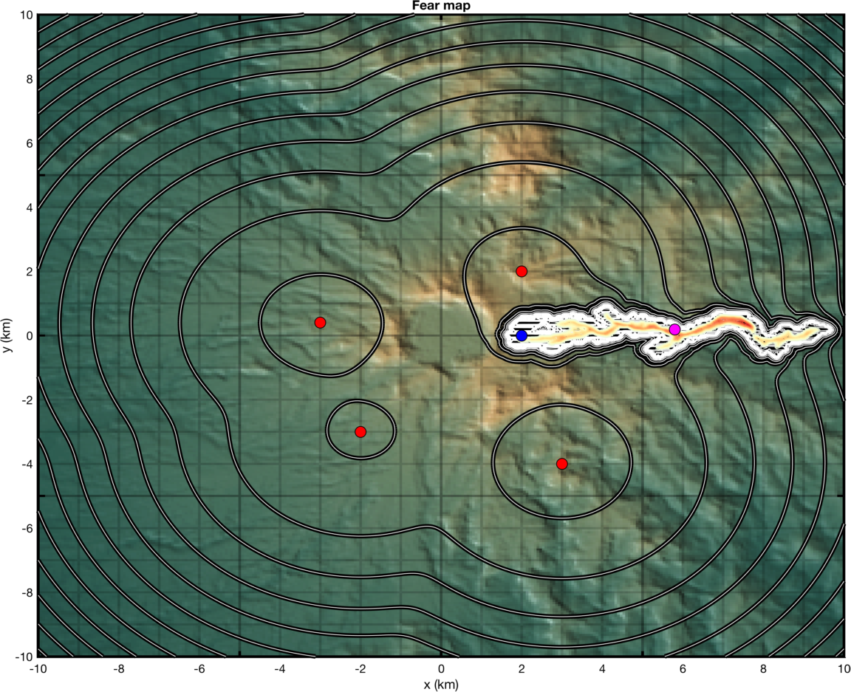
Broad indices for impact
Q: Knowing multiple simulations, can we estimate ‘impact’ or ‘cost’ of a lahar event?
Perhaps one way: develop a metric that factors in population density and distance from high-density populations.
Toy example: set 4 ‘cities’ with population density p(x,y).
Calculate metric that scales with p(x,y) and D(x,y), minimal distance from (x,y) to a point ‘touched’ by flow.
Contours indicate level sets of ‘fear’
High densities increase cost.
Large if each person is close to the passage of fluid

Slide 12
Thank you!
Questions?

